Slide 1
SHOPPING APP PROJECT
Technologies used are-
React js
Javascript
Bootstrap
CSS
HTML
MongoDB
Node Js
Express

Slide 2
Functionalities achieved are
Only selected users can see dashboard.
User name will be displayed after login in register.
A Single page application with Routes.

Slide 3
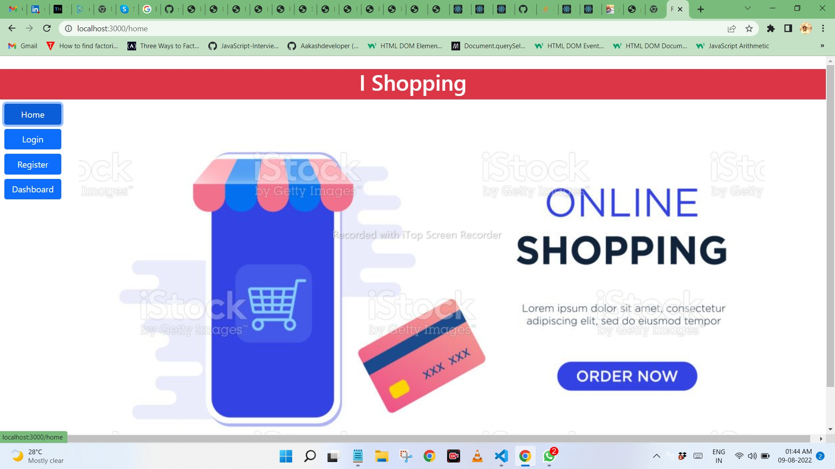

Slide 4
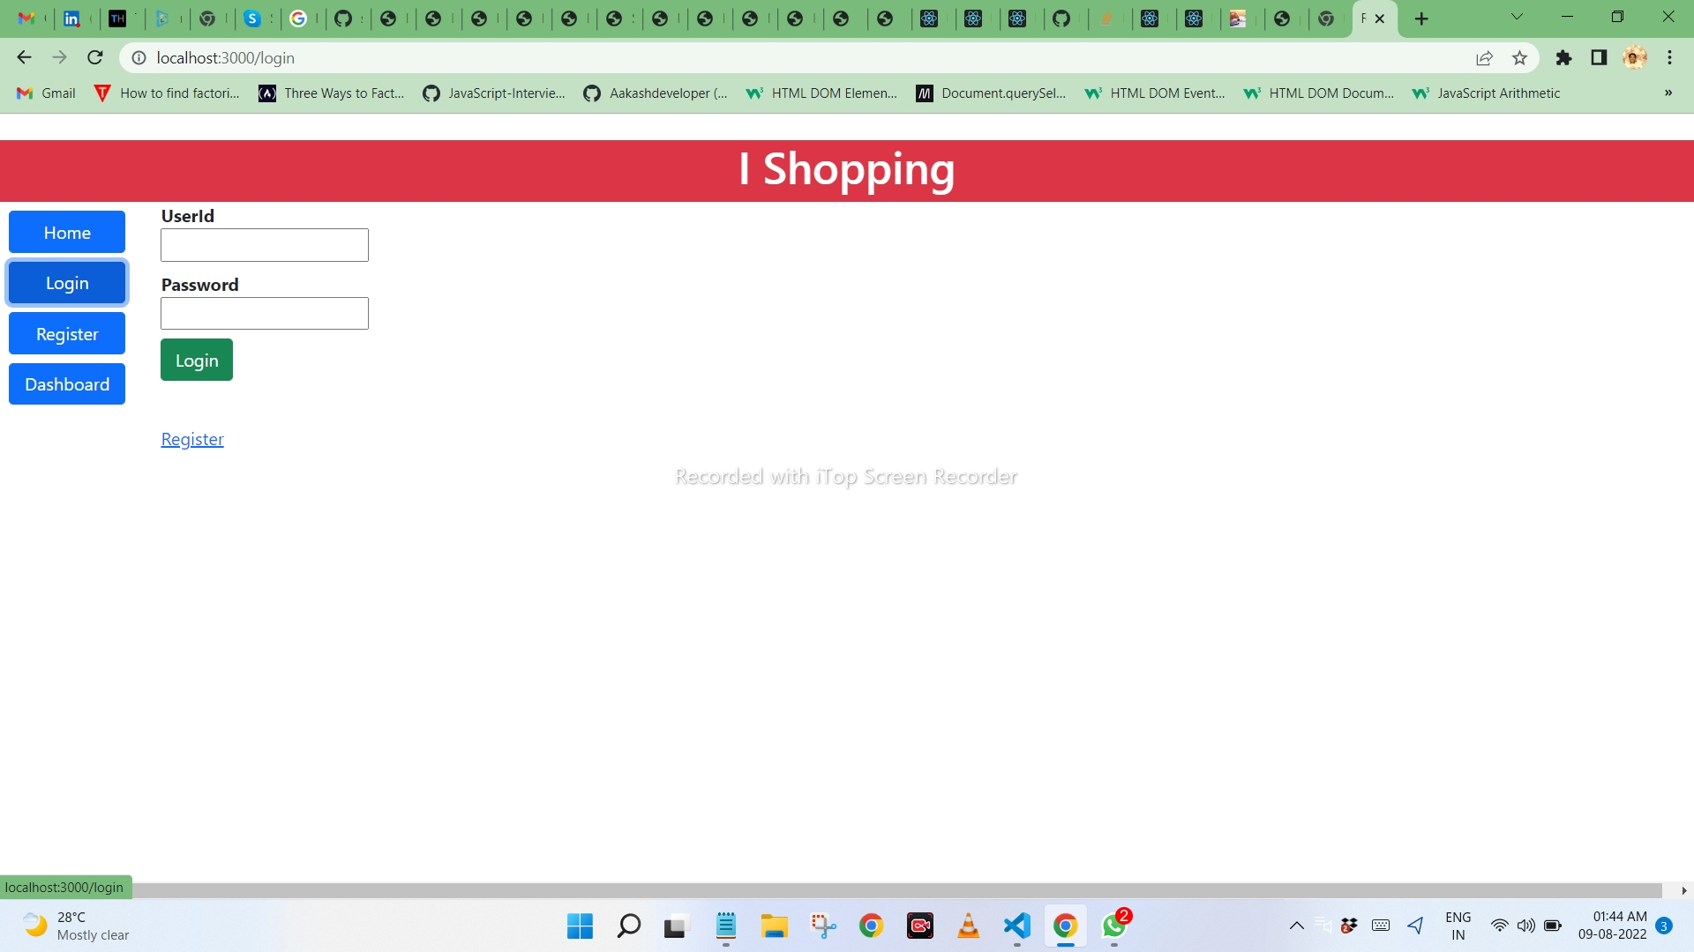

Slide 5
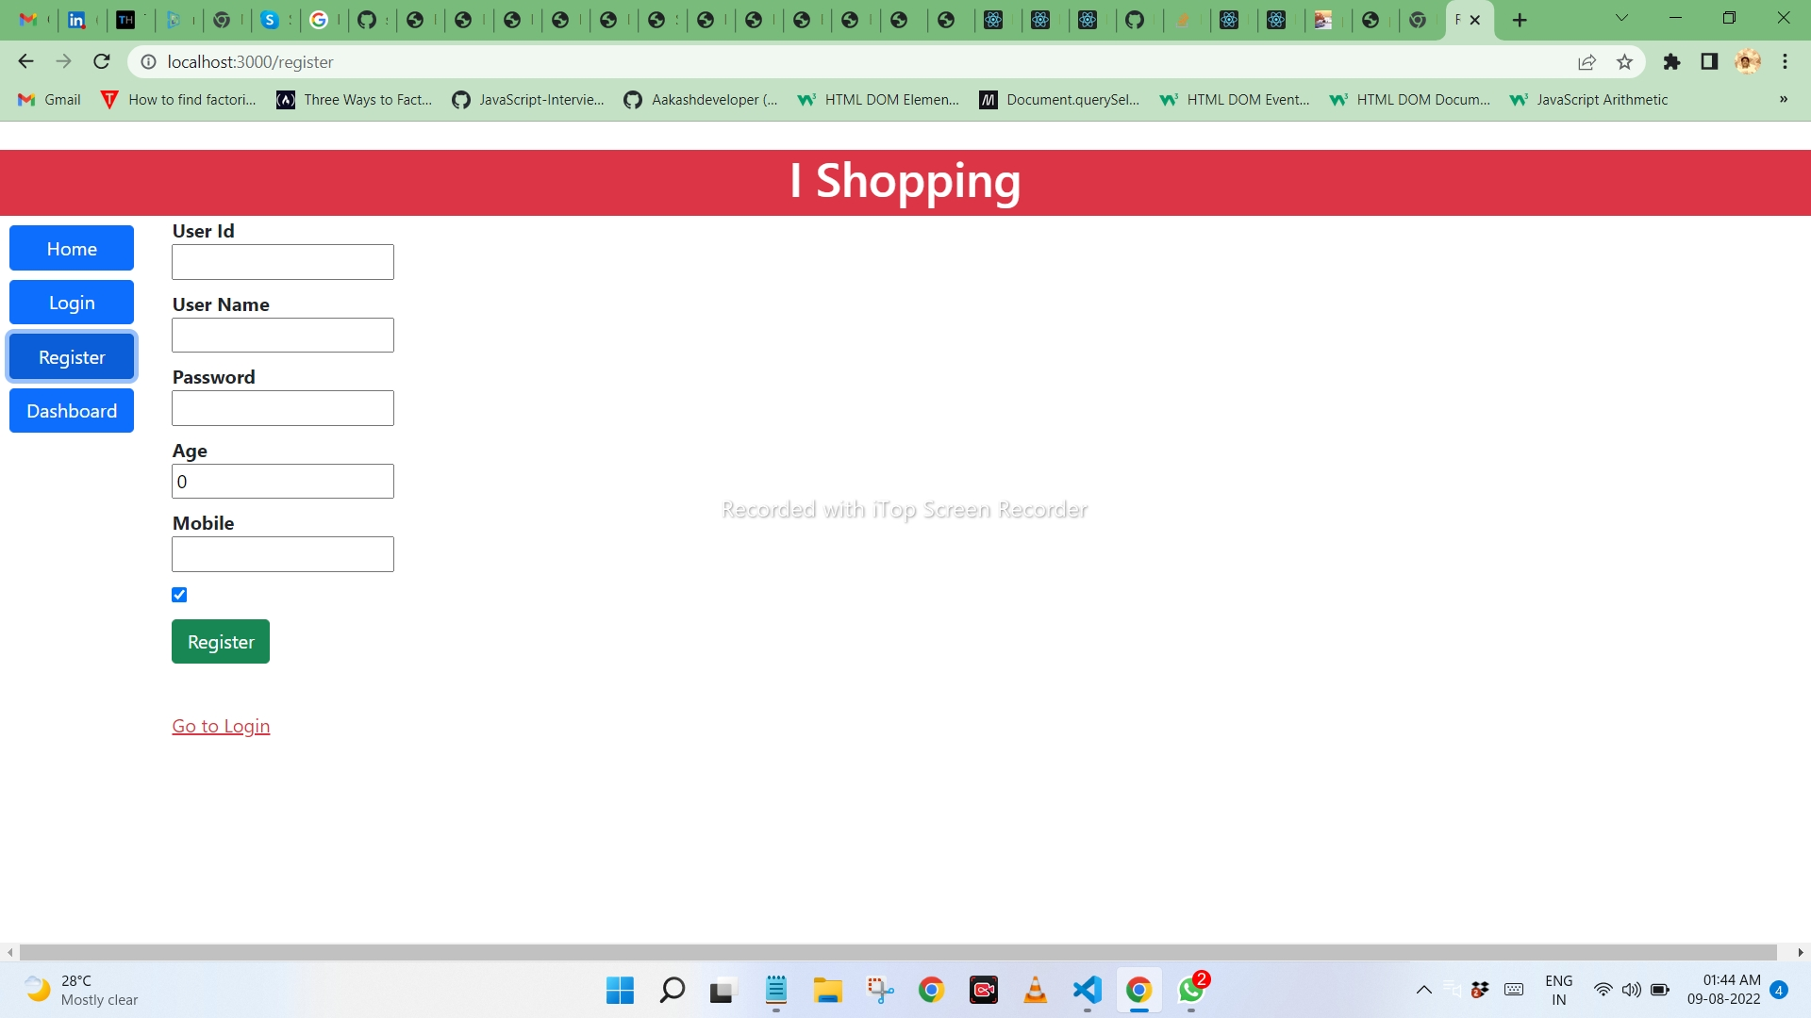

Slide 6
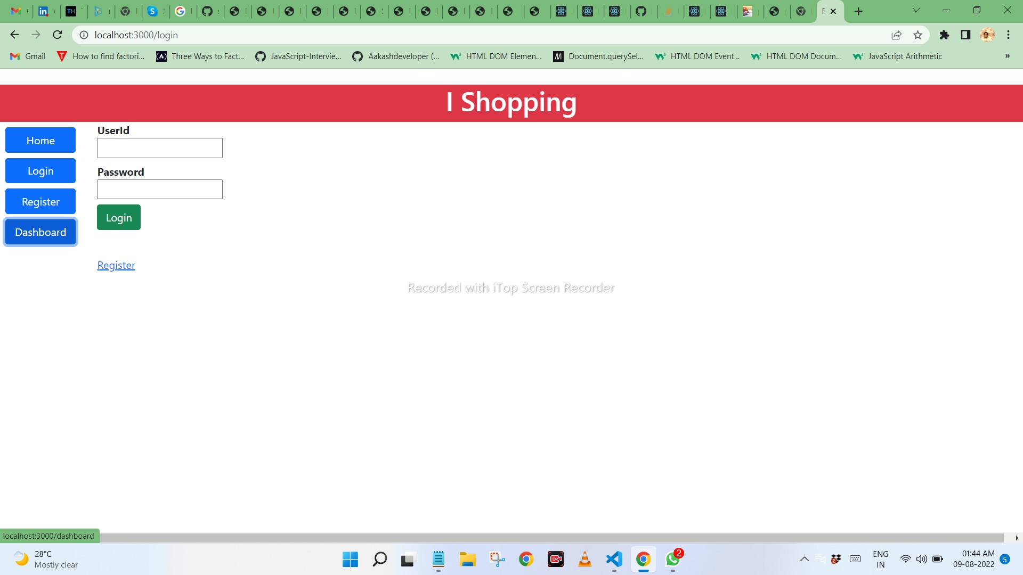

Slide 7
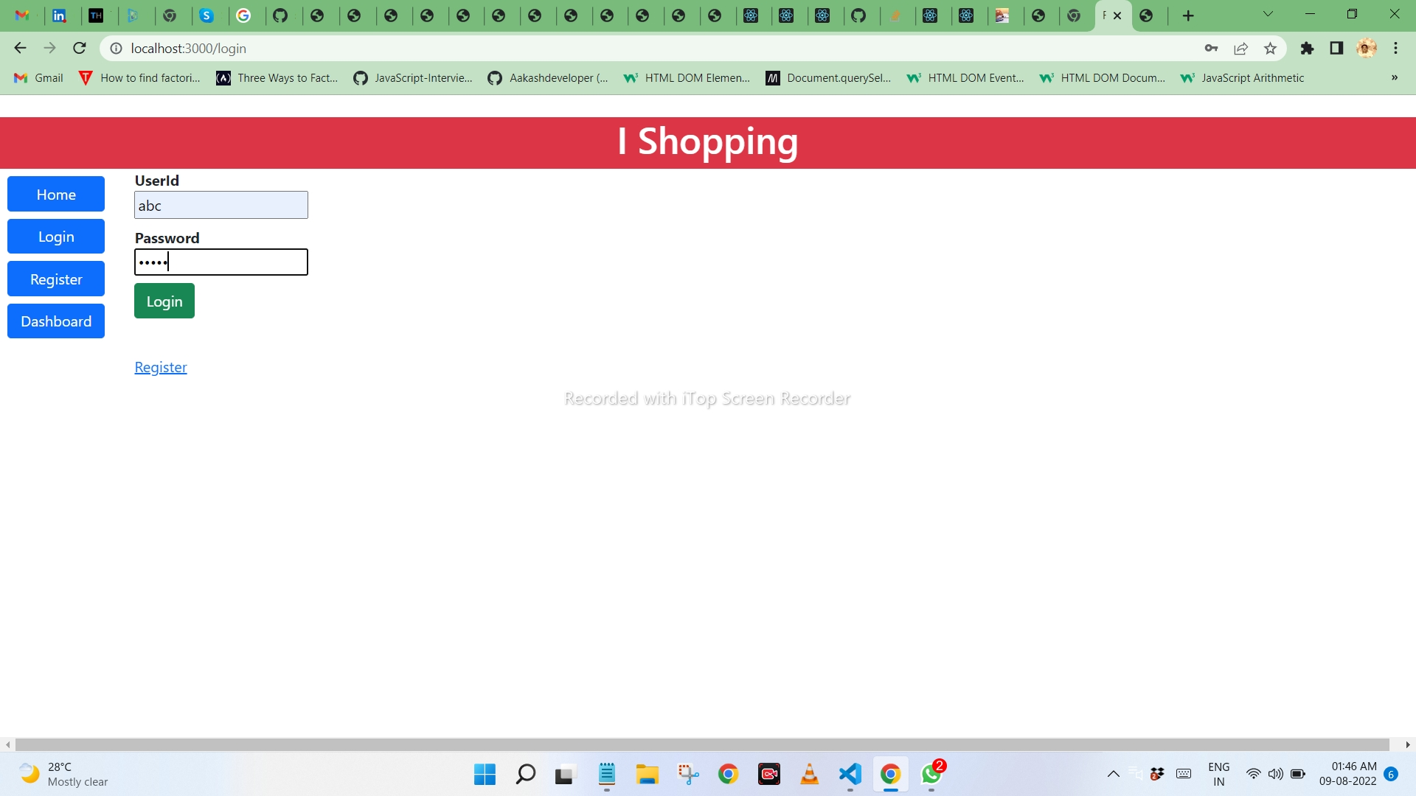

Slide 8
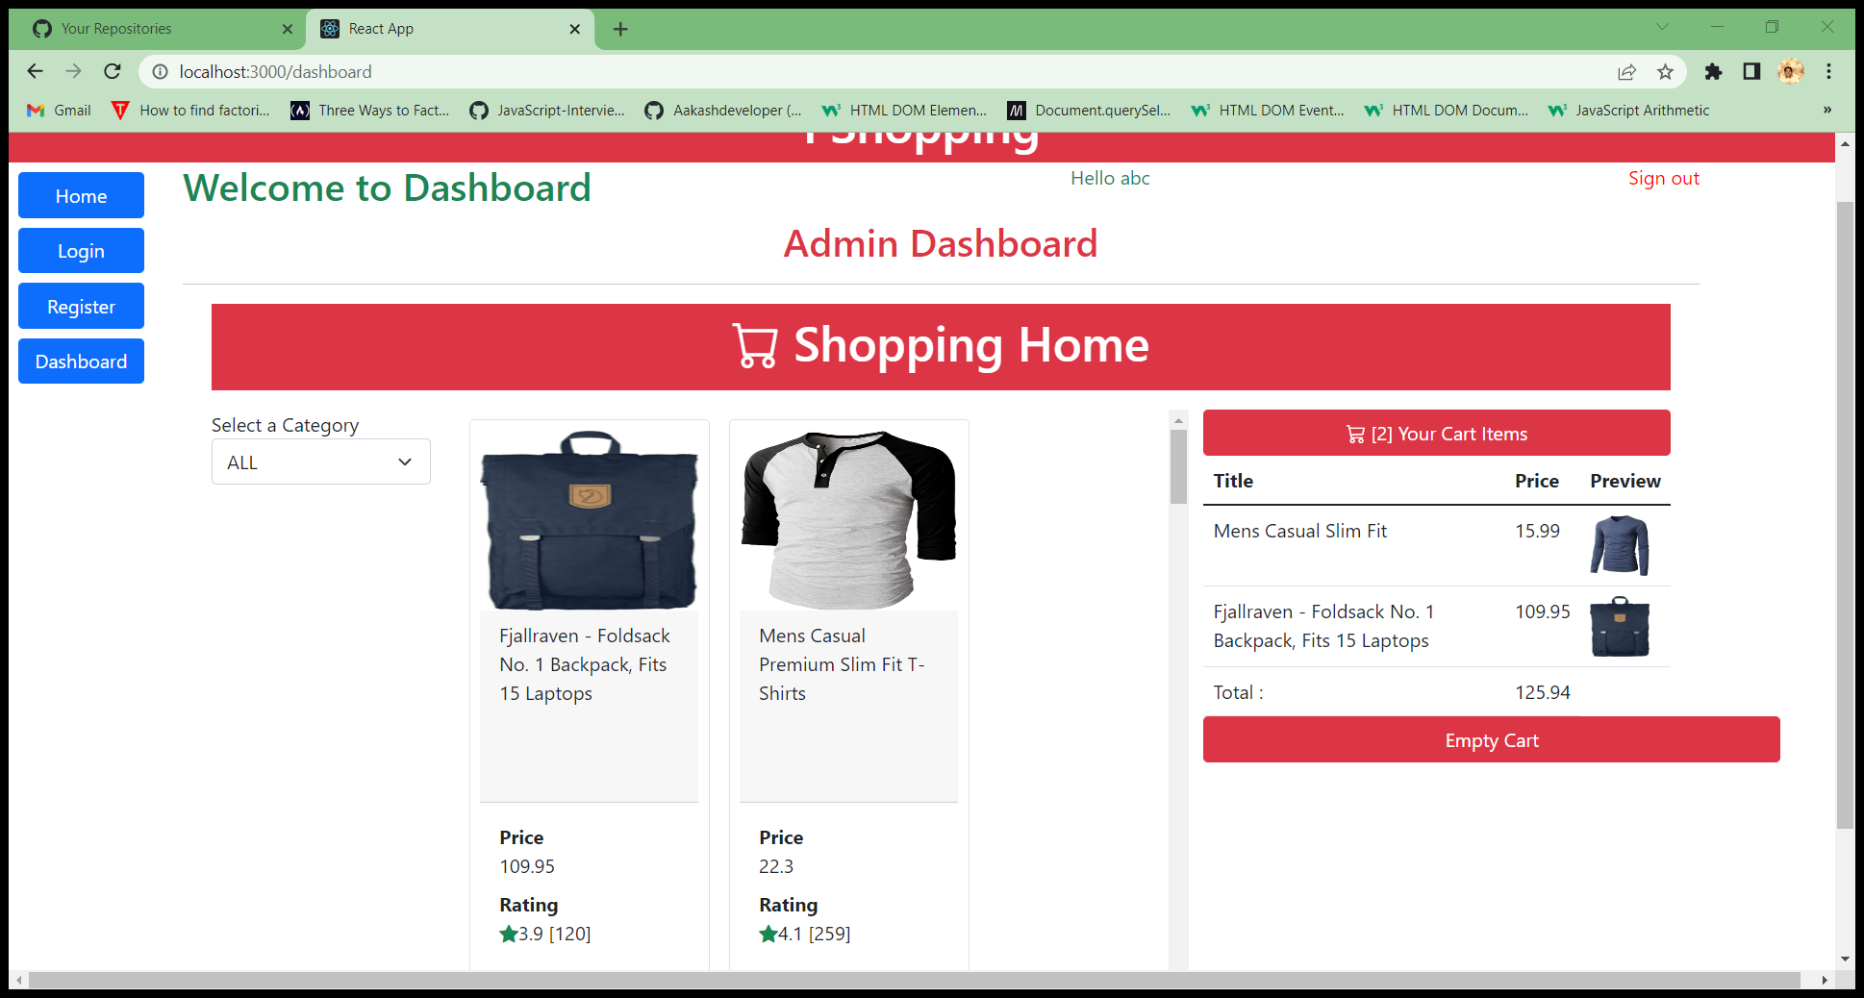

Slide 9
Other MERN stack react projects :
Project management tool
Review collector
Other JS projects :
Snake game
Spotify clone

